Slide 1



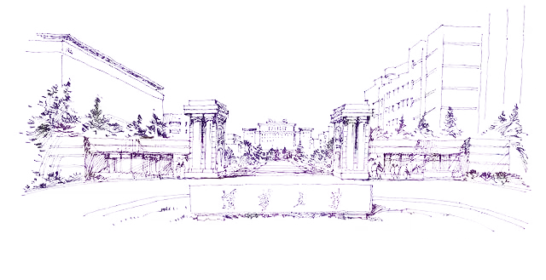


Fault-tolerant switching control strategy based on multi-sensor fault diagnosis scheme
Reported by 王萧诚
1/10/2020
Intelligent Robotics Lab, Shenzhen International Graduate School, Tsinghua University

Slide 2
Contents
1
Project Introduction
2
Methodology
3
Simulation & Evaluation
4
Conclusions

Slide 3
1. Project Introduction
Shenzhen International Graduate School, Tsinghua University

Slide 4


Project Introduction
Background
Problem Description
Recently, multi-sensor fusion related topics draw more interests along with the advances in sensor technology.
Multi-sensor fault diagnosis and fault-tolerant control can be applied not only in industrial production but also in many other areas such as vehicle control, robot manipulator control^{[1]}, etc.
Given a second-order LTI system;
2 sensors that may have faults in certain period of time;
We need to design the observers for the given system and observers;
We need to design the control law so as to achieve the goal of fault-tolerant control.
……
[1]. Mi Y, Xu F, Tan J, et al. Fault-tolerant control of a 2-DOF robot manipulator using multi-sensor switching strategy[C]. Chinese control conference, 2017: 7307-7314.

Slide 5
2. Methodology
Shenzhen International Graduate School, Tsinghua University

Slide 6
Methodology
System description
Reference system
Measurement equations
State observers
Detectable

Slide 7
Methodology
Error definitions
Control law

Slide 8
3. Simulation & Evaluation
Shenzhen International Graduate School, Tsinghua University

Slide 9
Simulation & Evaluation
White noise w
Performance
fault₁
Mean = 0
Variance = 0.0001
|w|≤0.2
fault₂

Slide 10
Simulation & Evaluation
White noise w
Performance
fault₁
Mean = 0
Variance = 0.0001
|w|≤0.2
fault₂

Slide 11
4. Conclusions
Shenzhen International Graduate School, Tsinghua University

Slide 12
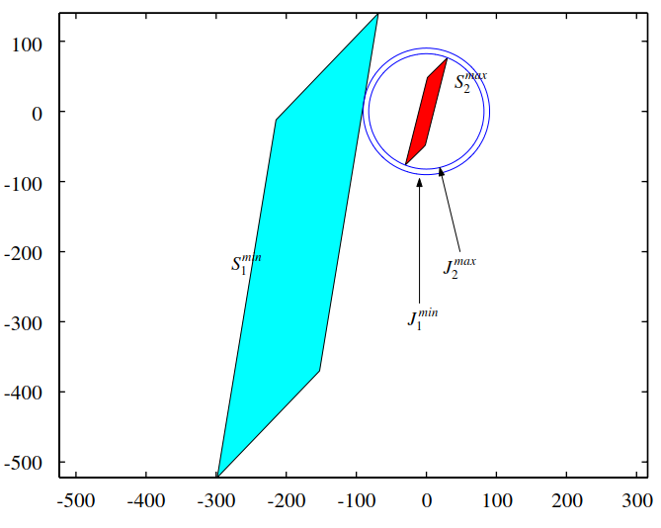
Conclusions & Further Discussion
Conclusions
Further Discussion
A fault-tolerant switching control strategy based on multi-sensor fault diagnosis scheme is investigated.
It shows good performance when certain fault happens in specific sensor. The robustness is brought up by the multi-sensor fault diagnosis scheme.
Through deduction of model formula, I learned more about fault diagnosis theories and improved my debugging abilities.
Selection of system parameters
Analysis of the invariant sets
……

Slide 13
Thanks for listening
1/10/2020

